Slide 1
READING YOUR Rent History

Slide 2
Reasons
DO YOU LIVE IN A RENT STABILIZED APARTMENT
KNOWLEGE IS POWER
BEING OVERCHARGED
PREFERENTIAL RENT
MCIs AND IAIs PROPERLY APPLIED
CURRENT CIRCUMSTANCES
HOW RESPONSIBLE IS MY LANDLORD

Slide 3
Requesting your Rent History
FILL OUT THE ONLINE CONTACT FORM
CAALLING THE RENT INFO HOTLINE AT 718-739-6400
VISITING YOUR BOROUGH OR DISTRICT OFFICE IN PERSON
REQUESTING YOUR RECORDS VIA EMAIL AT ORArecords@nyshcr.org

Slide 4
Sources of Rent Increases
2018-2019 APARTMENT & LOFT ORDER #50
VACANCY INCREASE OR Fact Sheet #5
MCIs AND IAIs
PREFERENTIAL RENTS or FACT SHEET #40
HISTORY OF RENT INCREASES

Slide 5
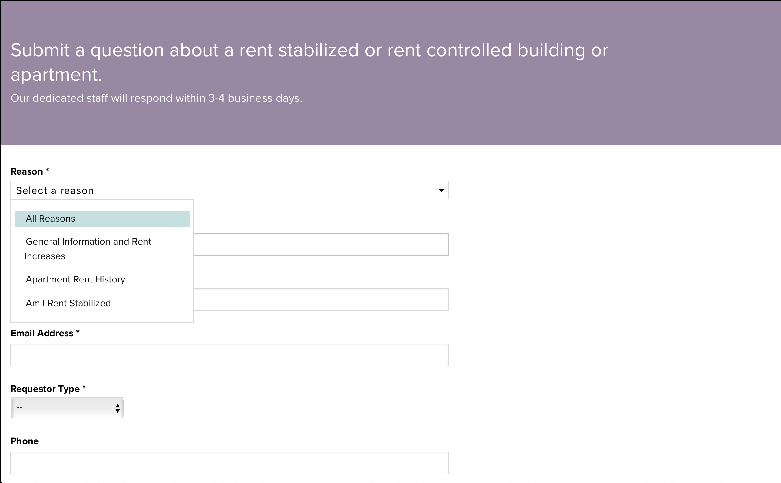
Rent History: Online contact form

Slide 6
Rent History Terms
RS = rent stabilized
V = vacant
PE = permanently exempt
RC = rent controlled
TE = totally exempt
W = paid weekly
NC = filing date was not recorded

Slide 7
Rent History Terms
VAC/LEAS = VACANCY LEASE
LEAS/RNL = LEASE RENEWAL
IMPRVMNT = IMPROVEMENT
PREF RENT = PREFERENTAIL RENT

Slide 8
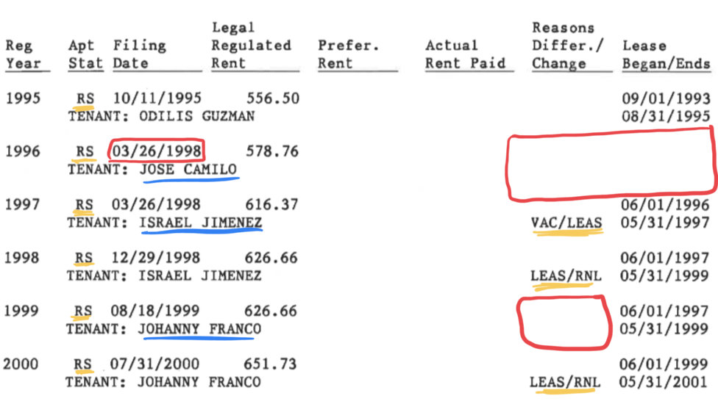
Rent History Examples

Slide 9
Rent History Notes
(I) = INITIAL YEAR OF REGISTRATION FOR UNIT
(D) = INDICATES THAT YEAR AS THE YEAR THE UNIT WAS VACANCY DECONTROLLED
(A) = INDICATES THAT AN AMMENDMENT TO THE ANNUAL APARTMENT REGRISTRATION WAS FILED BY THE OWNER

Slide 10
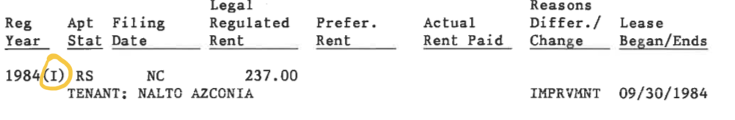
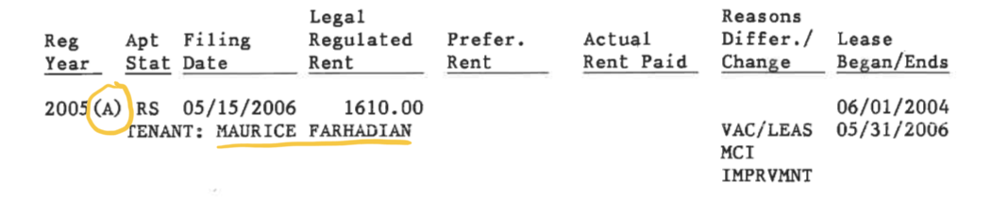
Rent History Notes: Examples

Slide 11
A look at my Rent History
LARGE RENT INCREASE FROM: 2004-2005
OWNER OCCUPANCY AND MCI: 2005
CHANGE TO PREFERENTIAL RENT: 2007
SAME YEAR AMMENDMENTS: 2003-2005
RESET PREFERENTIAL RENT: 2014
CURRENT RENT IS ABOVE THRESHOLD 2013-2016
STILL LIVE IN A RENT-STABILIZED UNIT

Slide 12
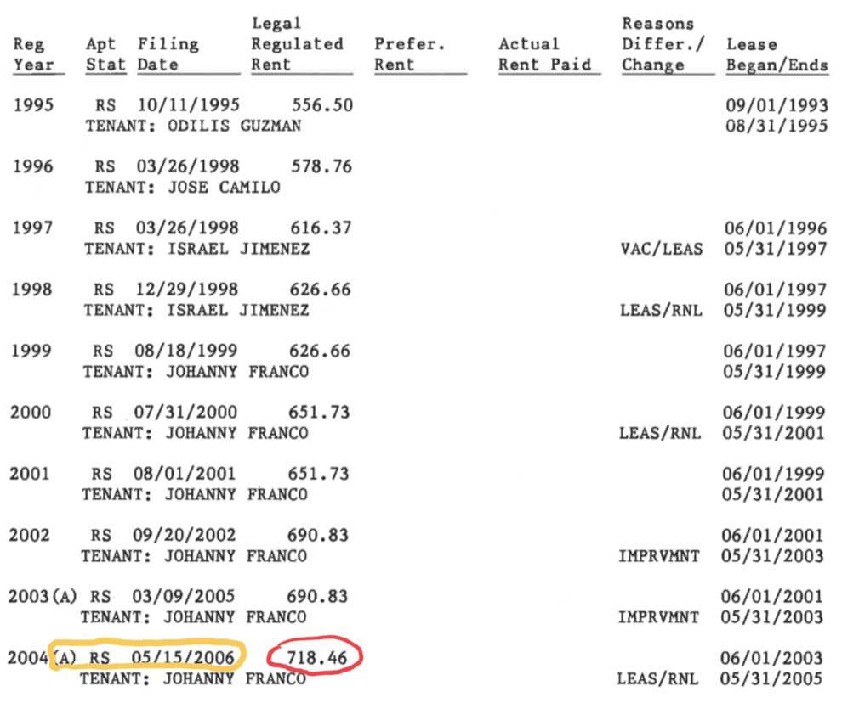

Slide 13
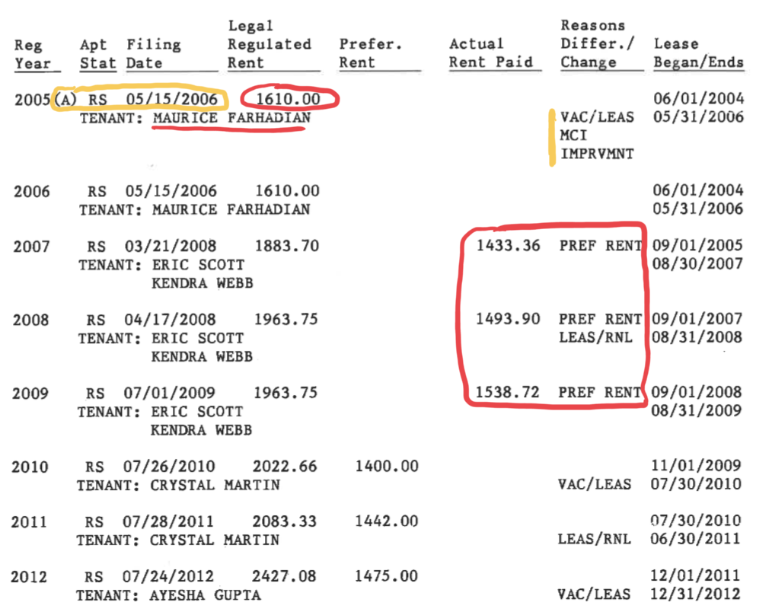

Slide 14
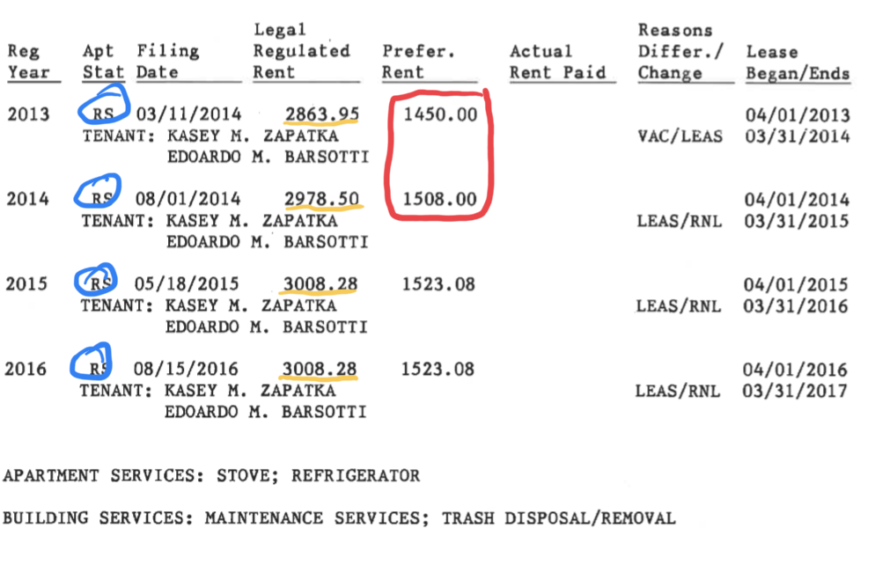

Slide 15
Conclusions
CURRENTLY LIVE IN RENT-STABILZIED APARTMENT
NO DISCLOSURE OF PREFERENTIAL RENT ON LEASE, SO MY PREFERENTIAL RENT IS MY LEGAL RENT
UNIT IS SUBJECT TO DE-CONTROL BECAUSE PAST STATUE OF LIMITATIONS
IMPACT ON NEXT TENANT

Slide 16
Takeaways
IMPORTANT TO KNOW WHAT IS IN YOUR RENT HISTORY
THERE ARE MANY POSSIBLE SCENARIOS AND IT’S IMPORTANT TO KNOW THEM
COLLECTIVE SOLIDARITY AND INDIVIDUAL PROTECTION

Slide 17
Resources
ACCESSING YOUR APARTMENT’S RENT HISTORY
RENT-STABILIZED BUILDING LIST
FACT SHEET #40: PREFERENTIAL RENTS
MET COUNCIL ON PREFERENTIAL RENTS

